Slide 1
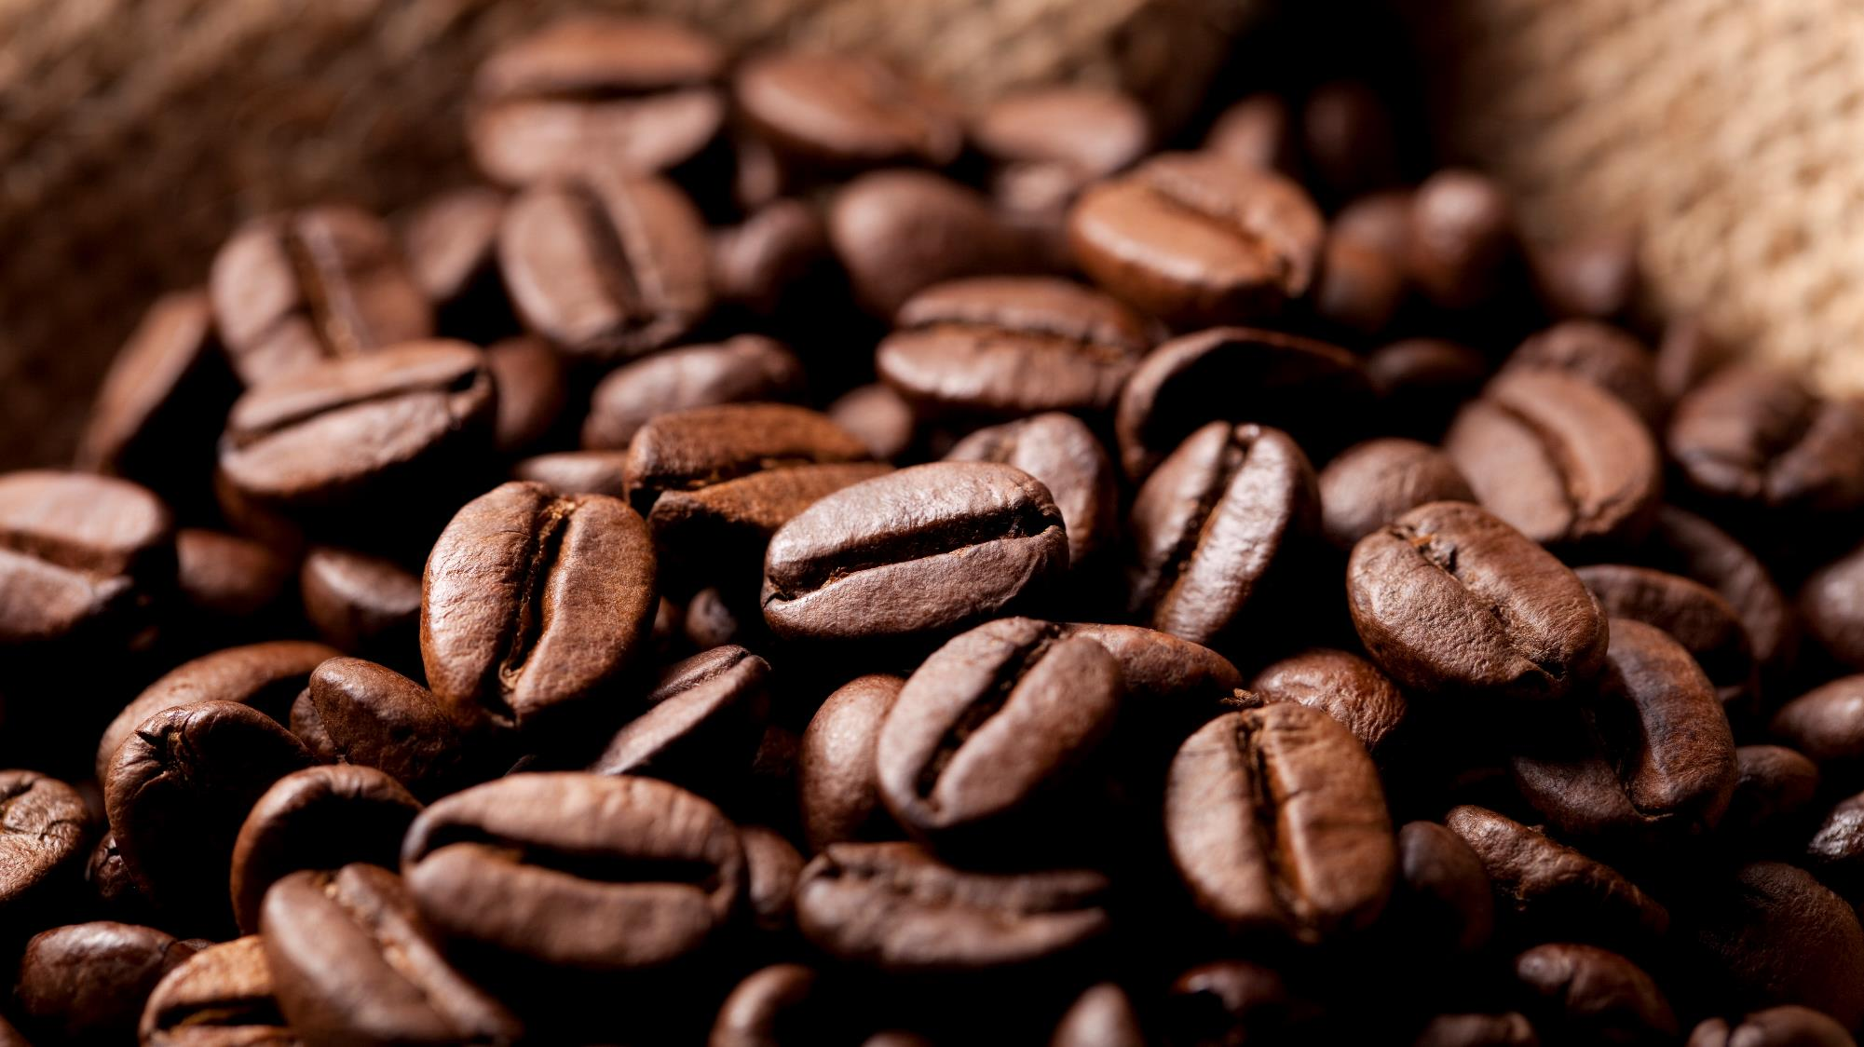
Bright Coffee SHOP
A Place between Home & Office

Slide 2
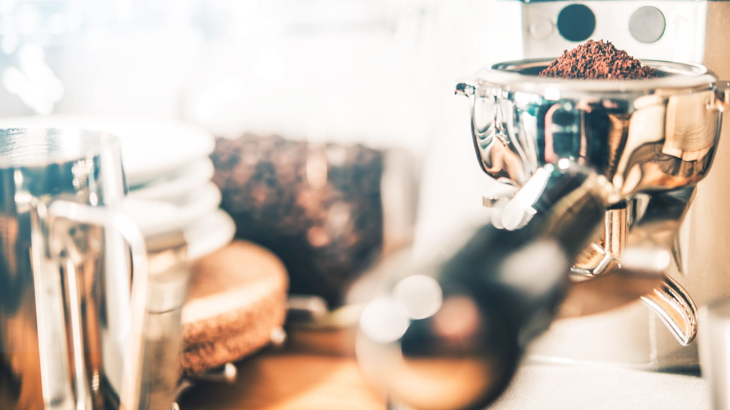
Problem statement
Bright Coffee Shop has experienced steady sales over the past few years, but the leadership team recognizes that growth opportunities remain untapped. With the appointment of a new CEO, the company is entering a pivotal phase where data‑driven decision making will be critical to shaping future strategy.
The challenge lies in transforming raw historical transactional data into actionable business insights. While the dataset captures daily sales across products, times of day, and customer behaviors, it has not yet been fully leveraged to answer key strategic questions:
Which products consistently drive revenue and profitability?
At what times does the store perform best, and where are the gaps?
What trends can be identified across different product categories and time intervals?
How can these insights inform marketing, inventory, and customer engagement strategies?
Without clear visibility into these patterns, the CEO risks making decisions based on intuition rather than evidence. My role as a Junior Data Analyst is to bridge this gap using Miro, Databricks, SQL, Excel, and PowerPoint to uncover insights that will guide the CEO in growing revenue, optimizing product performance, and enhancing customer experience.

Slide 3
Bright Coffee Shop Sales Insights
Revenue Analysis
Store Analysis
Product Analysis

Slide 4

REVENUE ANALYSIS

Slide 5
Revenue BY MONTH
Consistent Growth: Monthly revenue showed a steady upward trend from January totaling to R81,677.74 and June totaling to R166,485.88, respectively.
Peak Month: June recorded the highest revenue, nearly doubling January’s performance.
Quarterly Comparison: Quarter 2 (Apr–Jun) outperformed Quarter 1 (Jan–Mar) significantly, with revenue increasing by about 68%.
Acceleration Point: The sharpest jump occurred between March with R98,834.68 and April with R118,941.08 , marking the start of strong growth momentum.
Balanced Performance: Each month’s store revenue streams remain closely aligned, suggesting stable product or store contributions.
Seasonal factors may be driving higher sales in the second quarter, indicating opportunities to replicate strategies earlier in the year.

Slide 6
Revenue Contribution by Day Breakdown
Brunch dominates: Brunch (9am–11:59) contributes the largest share of revenue at 31.51%, making it the most profitable time slot.
Late Lunch is strong: The late lunch period (3pm onwards) accounts for 27%, showing sustained customer activity later in the day.
Breakfast steady: Breakfast (7am–8:59) contributes 24.06%, indicating consistent early‑morning demand.
Lunch underperforms: Lunch (12pm–2:59) is the weakest slot at 17.44%, suggesting potential for targeted promotions or menu adjustments.
Strategic implication: Marketing efforts could focus on boosting lunch sales while capitalizing on brunch’s strong performance.

Slide 7
store Location ANALYSIS

Slide 8
Revenue By sore & Day breakdown
Balanced Store Performance: All three locations (Astoria, Hell’s Kitchen, Lower Manhattan) contribute almost equally to total revenue which is approximately R230 000 each.
Brunch leads across stores: Brunch is the strongest time slot overall (R220,162.06), with Hell’s Kitchen contributing the highest brunch revenue (R84,406.64).
Late Lunch strength in Astoria: Astoria dominates late lunch sales (R80,497.05), significantly higher than the other two stores.
Breakfast preference in Lower Manhattan: Breakfast revenue is highest in Lower Manhattan (R71,255.25), showing strong early‑morning demand there.
Strategic implication: Each store has a unique strength, Astoria in late lunch, Hell’s Kitchen in brunch, Lower Manhattan in breakfast. That can guide tailored marketing and inventory strategies.

Slide 9
Quantities sold per product & store location
Coffee dominates: Coffee is the single largest product category, with 42,142 units sold, showing it as the core revenue driver.
Tea strong second: Tea follows closely with 32,808 units sold, confirming strong demand for hot beverages beyond coffee.
Bakery steady: Bakery items contribute 22,796 units (weekday + weekend), making them a consistent complementary category.
Drinking Chocolate niche: Drinking chocolate accounts for 11,468 units, smaller but still notable, especially on weekdays.
Branded & packaged items low: Branded products (747 units) and packaged chocolate (487 units) are minimal, suggesting limited traction in retail merchandise.
Weekday vs Weekend: Weekday sales (107,510) far exceed weekend sales (41,606), highlighting weekday traffic as the main driver.
Store strengths:
Astoria leads in Late Lunch and Coffee sales.
Hell’s Kitchen performs best in Brunch and Flavours.
Lower Manhattan dominates Breakfast and Bakery sales.
Sum of Number_of_sales | Column Labels
Row Labels | Astoria | Hell's Kitchen | Lower Manhattan | Grand Total
Weekday | 36 584 | 36 545 | 34 381 | 107 510
Bakery | 5 320 | 5 459 | 5 674 | 16 453
Branded | 187 | 81 | 259 | 527
Coffee | 14 523 | 14 533 | 13 086 | 42 142
Coffee beans | 361 | 522 | 370 | 1 253
Drinking Chocolate | 3 076 | 2 712 | 2 468 | 8 256
Flavours | 1 068 | 1 717 | 2 068 | 4 853
Loose Tea | 250 | 346 | 277 | 873
Packaged Chocolate | 78 | 135 | 132 | 345
Tea | 11 721 | 11 040 | 10 047 | 32 808
Weekend | 14 015 | 14 190 | 13 401 | 41 606
Bakery | 1 969 | 2 158 | 2 216 | 6 343
Branded | 92 | 38 | 90 | 220
Coffee | 5 502 | 5 654 | 5 118 | 16 274
Coffee beans | 141 | 198 | 161 | 500
Drinking Chocolate | 1 224 | 1 051 | 937 | 3 212
Flavours | 422 | 653 | 862 | 1 937
Loose Tea | 94 | 139 | 104 | 337
Packaged Chocolate | 32 | 62 | 48 | 142
Tea | 4 539 | 4 237 | 3 865 | 12 641
Grand Total | 50 599 | 50 735 | 47 782 | 149 116

Slide 10
Product ANALYSIS

Slide 11
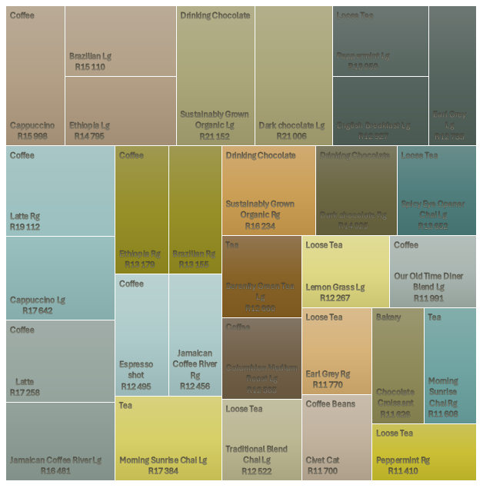
TOP 30 PRODUCTS BY REVENUE
Coffee is the backbone: Multiple coffee variants (Latte, Cappuccino, Ethiopian, Brazilian, Jamaican blends, Espresso) dominate the list, showing coffee as the primary revenue driver.
Drinking Chocolate is highly profitable: Sustainably Grown Organic and Dark Chocolate (both large and regular sizes) top the list, collectively generating over R72k, making chocolate drinks a strong competitor to coffee.
Tea & Loose Tea hold strong positions: Morning Sunrise Chai, Serenity Green Tea, Earl Grey, Peppermint, and English Breakfast consistently appear, confirming tea’s importance in diversifying revenue streams.
Bakery presence is limited but impactful: Chocolate Croissant is the only bakery item in the top 30, yet it generates R11,625.98, showing potential for expanding bakery offerings.
Specialty & premium products stand out: Items like Civet Cat Coffee Beans (R11,700) and Jamaican Coffee River blends highlight demand for unique, premium experiences.
Large sizes outperform regular sizes: Across categories (coffee, tea, chocolate), large servings consistently generate higher revenue, suggesting upselling larger sizes is a proven strategy.

Slide 12
STRATRGIC Recommendations
REVENUE GROWTH
Large drinks consistently outperform regular sizes in revenue. Train staff to promote upgrades.
Specialty items (e.g., Civet Cat beans, Jamaican blends, organic chocolates) show strong demand. Position them as “signature experiences” with premium pricing.
Chocolate Croissant is the only bakery item in the top 30 but performs well. Introduce more premium pastries to capture cross‑sell opportunities.
Product Strategy
Optimize Core Categories: Coffee, tea, and drinking chocolate are the backbone. Ensure consistent quality, stock availability, and marketing focus.
Revitalize Underperformers: Branded merchandise and packaged chocolate have low traction. Consider redesigning packaging, bundling with drinks, or seasonal promotions.
Seasonal Innovation: Introduce limited‑time flavors (e.g., festive teas, summer iced coffees) to drive novelty and repeat purchases.
Store & Time Slot Optimization
Astoria → Strength in late lunch; expand afternoon promotions.
Hell’s Kitchen → Brunch leader; capitalize with brunch combos and loyalty offers.
Lower Manhattan → Breakfast stronghold; introduce Morning bundles for commuters.
Boost Lunch Sales: Lunch is consistently the weakest slot. Launch targeted campaigns (discounted lunch combos, loyalty points during 12–3pm).
Weekend Engagement: Weekday sales dominate. Create weekend family packages, live events, or weekend specials to grow weekend traffic.
Operational Excellence
Automate Reporting: Implement daily dashboards for store managers to monitor sales by product, time slot, and spend bracket.
Inventory Alignment: Stock more of high‑performing items (coffee, tea, chocolate drinks) and reduce waste from low‑performing categories.
Scalability: Use insights to prepare for multi‑location expansion, ensuring each store leverages its unique strengths.
Customer Engagement & Marketing
Loyalty Programs: Reward frequent buyers, especially during off‑peak slots (e.g., double points at lunch).
Data‑Driven Promotions: Use transactional insights to personalize offers (e.g., tea lovers get tea promotions, coffee loyalists get bundle deals).
Community Building: Position Bright Coffee Shop as a lifestyle brand — host coffee tastings, tea workshops, or chocolate pairing events.

Slide 13
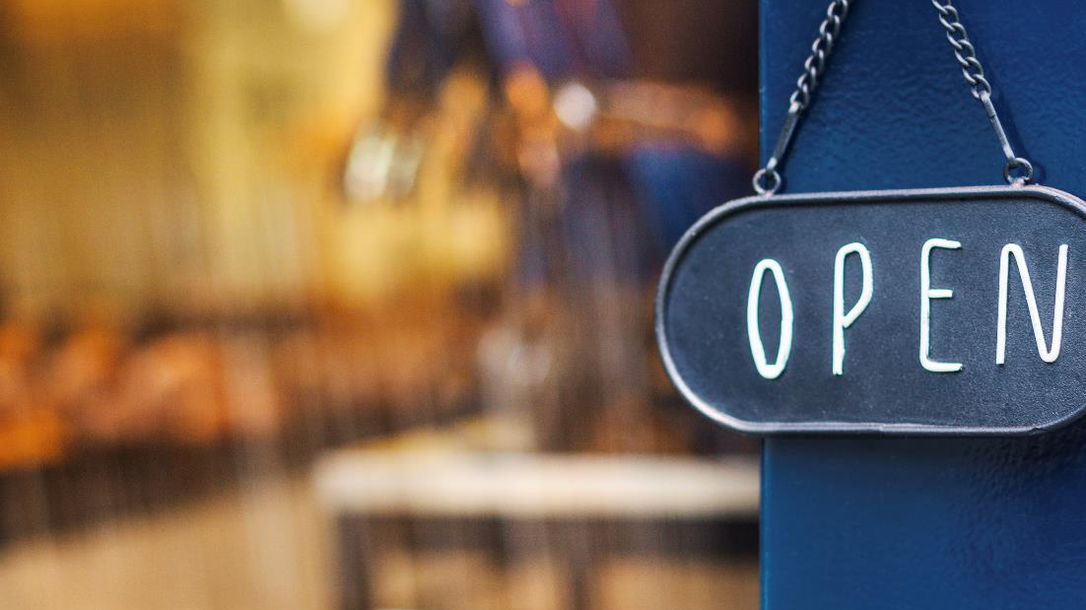
Thank You

